Slide 1

“ChatGPT for Suicide Risk Assessment on Social Media: Quantitative Evaluation of Model Performance, Potentials and Limitations”
Hamideh Ghanadian, Isar Nejadgholi, Hussein Al Osman
University of Ottawa, Ottawa, Canada
National Research Council Canada, Ottawa, Canada
Name: Purobi Paromita
ID:20301214
Section: 1
Faculty:
Mr. Annajiat Alim Rasel
Mr. Md Sabbir Hossain

Slide 2
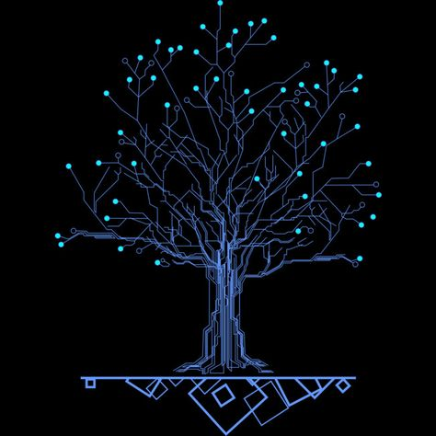
Outline:
Introduction
Motivation
Contribution
Dataset
Methodology
Result
Limitation
Synthesis
Conclusion

Slide 3
Motivation:
Suicide Risk Detection
Making sure if chatgpt could be a reliable tool to detect suicide risks
Interact with People
Emphathize with people who are suffering with suicidal thoughts or depression.

Slide 4
Contribution:
Result Comparison
ALBERT
DistilBERT
Evaluation with Zero-shot and Few-shot Learning
Temperature Parameter

Slide 5
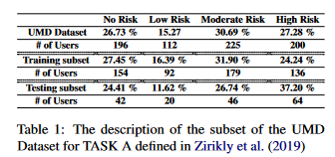
Methodology:
Dataset:
Evaluate with ALBERT & DistilBERT classifiers
Trainer class from Huggingface
Evaluating for zero-shot & few-shot learning
Primary input system(message parameter)
Controlling randomness and responses with temperature value
University of Maryland Reddit Suicidality Dataset(UMD)
Reddit posts and Comments
Four-point scale [(a) No risk, (b) Low risk, (c) Moderate risk, and (d) High risk]
Three subsets

Slide 6
Limitations:
First Limitation:
Does not measures the other safety criteria like biases or privacy issue.
Second Limitation:
did not explore the use of chatgpt in ongoing monitoring

Slide 7

Synthesis:
Suicide Detection
Spread Awareness
Decrease Suicide rate in society

Slide 8

THANK YOU

